Slide 1

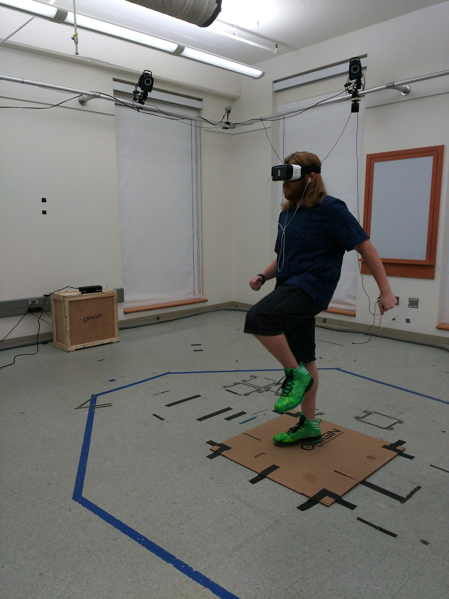
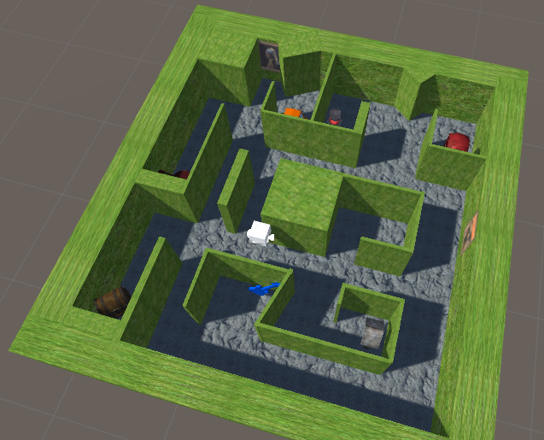
Locomotion Methods for Mobile Virtual Reality using Samsung Gear VR
Yuzhou Huang Electrical Engr. & Computer Science Vanderbilt University yuzhou.huang@vanderbilt.edu | Richard Paris Electrical Engr. & Computer Science Vanderbilt University richard.a.paris@vanderbilt.edu | Bobby Bodenheimer Electrical Engr. & Computer Science Vanderbilt University robert.e.bodenheimer@vanderbilt.edu
Problem
Walking in large virtual reality environments is an unsolved problem. In evaluating methods of moving, one must consider criteria such as presence, usability, and sense of direction.
One method of moving is resetting. In this method, the user walks in a real-world space until they hit a boundary, upon which the user will rotate to the center of the real-world space, but 360 degrees in the virtual world. Thus, resetting creates an illusion of walking infinitely.
However, users with a small real-world space would find this method impractical. For them, walking-in-place would be a much more viable method. Rather than movement within the virtual space mapping to movement within the real world space, walking-in-place allows users travel simply by mimicking the motions of walking.
Unfortunately, previous studies have seemingly shown that walking-in-place affords users a poorer sense of scale, a part of sense of direction. Sense of scale is an integral part of spatial cognitive microgenesis, and without it, users will have difficult familiarizing themselves with unfamiliar virtual environments.
This study seeks to determine whether walking-in-place truly provides a poorer sense of scale than other methods – or whether users have more difficulty demonstrating sense of scale through walking-in-place.
Pilot Results
At present, only two pilot tests have been run for each condition. Sixteen subjects will be tested for each condition over the next few days.
It has generally been observed that users tend to underwalk while walking with Head-Mounted Displays (HMDs) in virtual environments. Interestingly however, all of our pilot subjects overwalked.
Average angular error would be 90 degrees if paths were determined by purely random guesses. We notice that all our pilot subjects have much lower average angular errors in comparison, thus indicating that they actively made decisions about the paths they walked, even though the angular errors were high. It may be that more training time with the interface is needed.
Conclusions
Both methods show promise, but further evaluation of them is needed. Neither pilot subject experience symptoms of simulator sickness while navigating for 45 minutes. Both subjects were able to learn and navigate the environment successfully. The Kinect sensor is more effective at tracking user body movements when the user is facing directly towards or away from the sensor (i.e. at 0° or 180°), and is less effective when facing sideways (i.e. 90° or 270°). This could have an influence on path choice. Both methods showed similar learning patterns.
Method
We evaluated subjects with a measure of environmental spatial ability known as the Santa Barbara Sense of Direction Scale.
Subjects were then
References
Preston Tunnell Wilson, Kevin Nguyen, Alyssa Harris, and Betsy Williams. 2014. Walking in place using the Microsoft Kinect to explore a large VE. Proceedings of the 13th ACM SIGGRAPH International Conference on Virtual-Reality Continuum and its Applications in Industry (VRCAI '14). ACM, New York, NY, USA, 27-33
Chrastil, E. R., & Warren, W. H. (2013). Active and passive spatial learning in human navigation: Acquisition of survey knowledge. Journal of Experimental Psychology: Learning, Memory, and Cognition, 39(5), 1520-1537
Acknowledgments: Tim McNamara and Amy Shelton for support and help. KinectVR, an open source software project used to get Kinect sensor data. Financial support from The Engineering Dean’s Office and NSF 1116988. We also thank our pilot subjects who participated in the pilot experiment.

